Slide 1
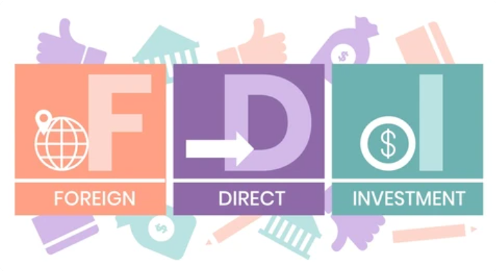
Cross-Country Analysis of the Effects of Economic Freedom and Labor Force Quality on Foreign Direct Investment Himanshu Sharma Rahul Bankey Rishabh Singh Simran Agichani

Slide 2

Understanding FDI and its Drivers
Why do we need to study FDI and its Drivers?
What are the monetary gains of studying FDI and its Drivers?
What factors influence foreign investors to invest in a particular country?

Slide 3
What is Foreign Direct Investment (FDI)?
Difference between Foreign Portfolio Investment and Foreign Direct Investment
Foreign Portfolio Investment | Foreign Direct Investment
Foreign Portfolio Investment or FPI refers to the investment made in the financial assets of an enterprise, based in one country, by the foreign investors. | Foreign direct investment or FDI pertains to international investment in which the investor obtains a lasting interest in an enterprise in another country.
An investor is inactive. | An investor is active.
Indirect investments in assets are made. | Direct investments in assets are made.
Investments made are short term in nature. | Investments made are long term in nature.
FPI are volatile in nature. | FDI are stable in nature.
Foreign direct investment (FDI) is a type of cross-border investment in which a resident of one economy establishes a long-term interest in and significant influence over a resident of another economy. The possession of 10% or more of the voting power in a business in one economy by an investor in another is evidence of such a relationship.

Slide 4
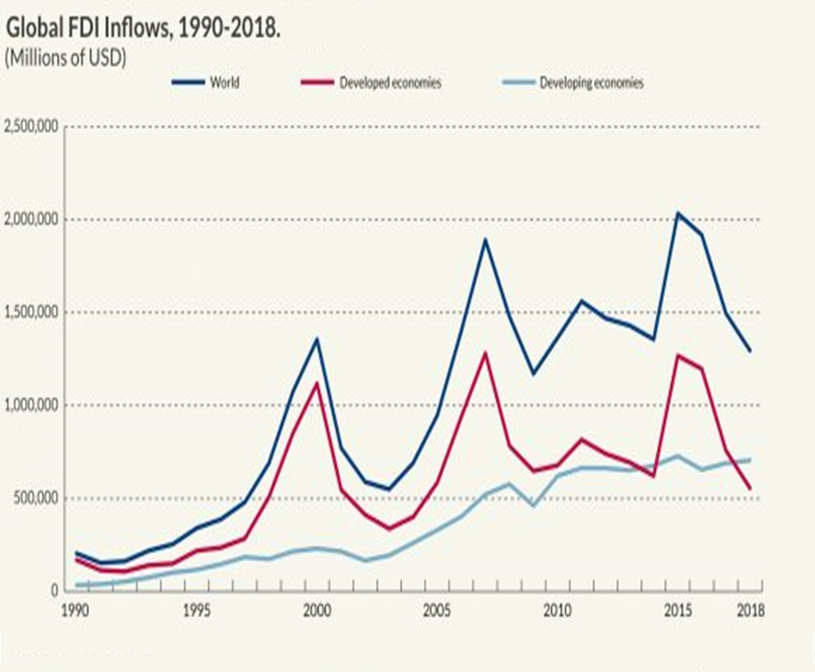
Problem Statement
Target is to identify the factors to help develop strategies that can attract more FDI inflows to the country, leading to sustainable economic growth and development.
Between 2000 and 2016 the share of FDI stock in global GDP increased from 22% to 35%.
In the 1990s, there was a surge in FDI inflows to developing countries. Developing countries that opened up their economies and implemented FDI-attractive policies were able to capitalize on this surge and achieve high rates of economic growth and development.
Following the sharp decline in global capital flows caused by the 2007-2008 global crisis, FDI flows to developing countries recovered faster than other components of global capital flows and remain high, accounting for roughly 10% of gross fixed capital formation.

Slide 5
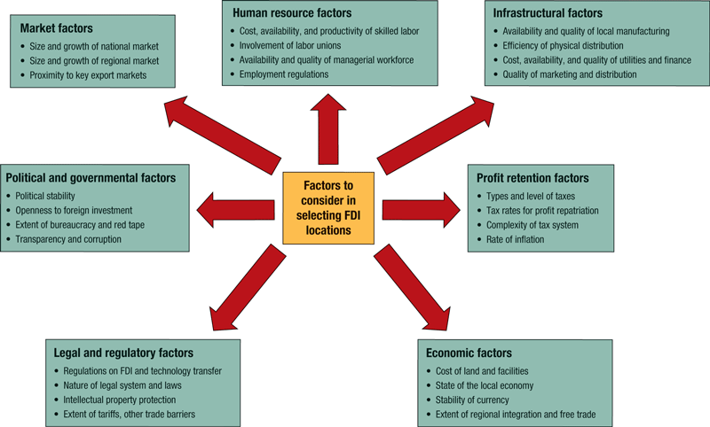
Determinants that influence FDI flows into a host country
The Economic Freedom Index provides a comprehensive measure of the consistency of a country’s institutions and policies with economic freedom. The index measures the degree of economic freedom present in five major areas:
Size of Government
Legal System and Property Rights
Sound Money
Freedom to Trade Internationally
Regulation of credit, labor, and business.
The labor force is considered a crucial factor in Foreign Direct Investment because it has a significant impact on the productivity and efficiency of the workforce.
Labor force with primary education as the highest level of education.
Labor force with secondary education as the highest level of education.
Labor force with tertiary education as the highest level of education.

Slide 6

Prior Work: Regression Research Papers

Slide 7
Source | Research question | Predictors | Findings
Sambharya & Rasheed (2015) | Does economic freedom in host countries lead to increased FDI? | Economic freedom Political freedom -voice and accountability Trade and investment Economic management Extent of government Participation in the economy State interference and corruption Wages and prices FDI stock | Government participation in the economy has a significant influence over FDI inflows at -6.4. State interference and corruption (average of Property Rights, Regulation and the Informal Market) has the highest coefficient value of -8.03, which implies that lower level of state interference and corruption has a significant impact on higher FDI inflows. Conclusively, both economic and political freedom are important for FDI.
Elfakhani & Mackie (2015) | What are the drivers of net FDI in BRIC countries? | Market Size GDP growth rate Trade balance Currency rate risk National Debt Investment Climate GDP per capita Human Capital Development No. of college degree graduates Incremental Post graduates Level of restriction on capital repatriation Quality of life Life expectancy at birth Population size Democracy index Corruption index Civil Liberty International property protection index Degree of economic openness | Social and economic/ financial factors such as number of post graduates, population growth and currency rate risk were the major influencing factors with coefficients value of 422.06, 1233.37, -152.33 resp. for inward FDI. Variables such as Democracy did not have any major impact on net FDI. Despite rising levels of corruption, India's improvements in health care as seen by longer life expectancies, continuous population growth, greater GDP per capita, and the preservation of property rights have made the country an appealing destination for FDI. China's one-party government and low inflation rates were the key contributing factors. For Brazil, democracy and its high degree of economic openness coupled with freedom from capital repatriation all worked in favor for attracting inward FDI The primary factors of FDI in Russia are the rise in GDP per capita and the improvement in living standards, despite the insufficient level of protection of property rights and civil liberties.
Rakesh B Sambharya Abdul A Rasheed, (2015),"Does economic freedom in host countries lead to increased foreign direct investment?", Competitiveness Review, Vol. 25 Iss 1 pp. 2 – 24
Said Elfakhani, Wayne Mackie, (2015),"An analysis of net FDI drivers in BRIC countries", Competitiveness Review, Vol. 25 Iss 1 pp. 98 - 132

Slide 8
Source | Research question | Predictors | Findings
Nelson et al. (2021) | What is the effect of higher education, GDP/capita, trade, and interest on FDI? | Labour force with primary education Labour force with secondary education Labour force with tertiary education Gender GDP per capita Trade(% of GDP) Real Interest rate(%) | Education at all levels of an OECD country’s labour force is positively associated with inward FDI. Tertiary education, on the other hand, has a greater impact on FDI than secondary and primary education. This is because primary and secondary education is primarily concerned with practical skills, whereas tertiary education is associated with advanced research programs requiring appropriate qualifications. ​ FDI is positively related to both genders. However, a regression analysis of the entire population reveals that males with primary and secondary education outperform females, with a total level of significance of nearly 1% versus 5% for the latter.
Kobeissi | What is the impact of Governance, Legal System and Economic Freedom on FDI in the MENA Region? | Governance Index Common Law (Legal System) Economic Freedom Inflation Level Wages Rate Technological Infrastructure GDP Per Capita Education Composite Risk Population Time Trend | The study shows that there is a positive impact of governance, legal system and economic freedom on the flow of foreign investment in the MENA region. Among the three determinants, governance showed the most significant results followed by legal system and then economic freedom. The relatively lower importance of the last two determinants could be due to the fact that investors from different countries have varying degrees of tolerance for imperfections in the host country's investment environment. When compared education and economic freedom along other factors education(0.015) had more impact than economic freedom(-1.191) . The most important factor in attracting foreign investors is profitable business opportunities.
Nelson, T. D., Smith, T. R., & Dodd, D. R. (2021). Teletherapy with children and adolescents: An updated review. Clinical Psychology: Science and Practice. Advance online publication. doi: 10.1177/0950422221997274
Kobeissi, N. (2005). Impact of Governance, Legal System and Economic Freedom on Foreign Investment in the MENA Regi. Impact of governance, legal system and Economic Freedom on foreign investment in the MENA region, Journal of Comparative International Management, Vol 8, No 1, 20-41.

Slide 9
Source | Research question | Predictors | Findings
Tag & Degirman (2022) | What is the relationship between economic freedom and foreign direct investment? | Economic freedom Government size Rule of law Sound money Life expectancy Trade freedom Regulations GDP growth FDI per capita | Economic freedom and Rule of law have a major influence on FDI inflow (co-efficient 26.6, 20.3) respectively. MNEs are attracted to countries having low restrictions on international trade, consistent with models of vertical FDI. Overall, our results indicate that institutions of economic freedom are among the key determinants of foreign direct investment flows.
Sethi et al. (2021) | What is the relationship between human capital and FDI? | GDP per capita Infrastructure Education primary Education secondary Education tertiary Trade Cost Labour Cost Real Exchange Rate GDP deflator Real GDP Growth Real Interest Rate FDI Inflow | One-unit increase in primary school enrolment is associated with a 1.5% increase in FDI. For high-income countries, a one-unit increase in primary school enrolment is associated with a 2.5% increase in FDI, and for low-income countries, a one-unit increase in secondary education is associated with a 22.2% increase in FDI. There is a high to low enrolment ratio with respect to primary, secondary and tertiary education as we move from high to low-income countries. The FDI inflows also decline from rich to poor countries. The larger countries (GDP) with greater infrastructure (mobile) and higher trade have high FDI flows. Higher primary education enrolment leads to higher FDI flows. The higher the GDP growth, the higher the FDI flows. The size of the Human capital and foreign direct investment 1207 market measured by GDP, the growth potential of the market measured by real GDP growth rate and the availability of infrastructure are the major factors that enhance the attractiveness of a country as an FDI destination
Mehmet Nasih Tag, Suleyman Degirmen (2022). Economic freedom and foreign direct investment: Are they related? Economic Analysis and Policy, Vol. 73.
Madhvi Sethi, Saina Baby, Aarti Mehta Sharma (2021). "A cross-country analysis of the relationship between human capital and foreign direct investment," Journal of Economic Studies, vol. 49(7), 1197-1211.

Slide 10
Source | Research question | Predictors | Findings
Moussa et al. (2015) | What is the effect of Economic Freedom on FDI? | Growth Import Export Trade Inflation Rate Interest Rate Economic Freedom Index | This investigation aims at measuring the power of economic freedom on FDI inflows especially for often neglected and conflict regions. GDP growth appears as locomotive of FDI as it generates significant coefficients of 0.16.07 in Oceania, 0.3209 in Sub-Saharan, and 0.1251 in post-Soviet. As well as, the role of trade in OC and SS is also remarkable. The negative impact of inflation and interest rates on FDI make sense as foreign investors wish these two variables to be lesser and stable to initiating or continuing their investment activities in that country. Moreover, the analysis reveals that GDP growth has a significant (0.2031) on FDI, which is also desirable for foreign investors.
Majeed et al. (2008) | What is the effect of Human Capital Development on FDI in Developing Countries? | GDP Expenditures on defense Expenditures on health Illiteracy rate Expenditures by government on wages Official development assistance Indirect taxes as a percentage of GDP Real lending interest rate Urban population tonnage of goods transported x kilometers traveled per million dollars of GDP measured in PPP terms vehicles per 1000 people percentage of growth of roads pavement Remittances | The effect of health expenditures is significant in explaining FDI inflows. The effect of illiteracy is negatively associated as a literate population can be made to cooperate for beneficial economic activities more easily. Lower interest rates stimulate the investment opportunities for domestic investors. Higher domestic investment leaves little room for the foreign investors, so lending interest rate positively determine FDI flows. The policy implications that we are offered are: • Expenditures on health facilities and education financing programs may be increased in the host countries at the cost of military expenditures and other non-productive spending. • It is of critical importance to maintain a high and sustainable level of GDP. Evidence has shown that a sustainable level of GDP attracts FDI.
Mohamed Moussa, Havva Çaha, Murat Karagöz (2015). Review of Economic Freedom Impact on FDI: New Evidence from Fragile and Conflict Countries. Istanbul Conference of Economics and Finance, ICEF 2015, Istanbul, Turkey.
Majeed, Muhammad Tariq and Ahmad, Eatzaz (2008). Human Capital Development and FDI in Developing Countries. Published in: Journal of Economic Cooperation and Development, Vol. 29, No. 3: pp. 79-104.

Slide 11
Data Sources & Collection Summary
PARTNER | COLLECTION PROCESS | UPDATE FREQUENCY | LINKS FOR DATA
OECD | Education and Labour market (INES-LSO activities) Survey European Commission (EC), International Labour Organization (ILO), Statistical Office of the European Union (EUROSTAT), United Nations Educational, Scientific and Cultural Organization (UNESCO) | Annually | https://www.oecd-ilibrary.org/education/education-at-a-glance_19991487
PWT version 10.01 | International Comparison Program (ICP) collects data on local prices every several years (benchmark years). | Annually | https://www.rug.nl/ggdc/productivity/pwt/?lang=en
World Bank | FDI data are using data from the United Nations Conference on Trade and Development (UNCTAD) and official national sources. | Annually | https://data.worldbank.org/indicator/BX.KLT.DINV.WD.GD.ZS
Heritage Foundation | Survey conducted by the Heritage Foundation and The Wall Street Journal. | Annually | https://www.heritage.org/index/explore?view=by-region-country-year

Slide 12
Table Description & Predictors
3. Sound Money
Money growth
Standard deviation of inflation
Inflation: most recent year
Freedom to own foreign currency bank accounts
4. Freedom to Trade Internationally
Tariffs
Regulatory trade barriers
Black-market exchange rates
Controls of the movement of capital and people
5. Regulation
Credit market regulations
Labour market regulations
Business regulations.
1. Economic Freedom:
Size of Government
Government consumption
Transfers and subsidies
Government investment
Top marginal tax rate
State ownership of assets.
2. Legal System and Property Rights
Judicial independence
Impartial courts
Protection of property rights
Military interference in rule of law and politics
Integrity of the legal system
Legal enforcement of contracts
Regulatory costs of the sale of real property
Reliability of police
6. Labour Force:
Country
Year
Labour force with primary education
Labour force with secondary education
Labour force with tertiary education
GDP per capita

Slide 13
Variables | Effect | Rationale
Size of govt. >Govt. Investment >Top marginal income tax rate | + - | The quality and availability of funds for infrastructure, education, and R&D can significantly impact a country’s business environment and attract foreign investment. A lower top marginal income tax rate can make a country more attractive to foreign investors by reducing the tax burden on their profits.
Legal System & Property Rights >Judicial Independence >Protection of property rights | + | Investors want to know that their property rights will be protected and that they can count on a fair legal system. A country with an independent judiciary is more likely to provide these assurances.
Sound Money >Freedom to own foreign currency bank accounts | + | Allowing foreign investors to hold bank accounts denominated in their home currency can make it easier for them to do business and manage their investments.
Freedom to trade internationally. >Mean Tariff Rate >Financial Openness >Regulatory trade barrier | - + - | A lower mean tariff rate can signal a more open and welcoming trade environment, making a country more attractive to foreign investors. A more open financial system can make it easier for foreign investors to bring money in and out of the country and invest in local businesses. When a country imposes regulatory trade barriers, it can limit the opportunities for foreign companies to access the domestic market & discourage them from investing in the country.
Regulation >Private sector credit >Hiring Regulations and minimum wage | + - | Access to credit can be an important factor for foreign investors, especially those who may need to borrow money to fund their investments. Strict hiring policies make it difficult for foreign companies to hire and fire employees. Also, if a country sets minimum wages at a high level, this can increase labor costs and can deter FDI.
Countries, Year | ? | Categorical variables needed for the analysis of various factors of FDI for different countries over a time period of 15 years.
Labour Force by education: Primary Secondary Advanced | ? | Labor force by education is an important predictor for FDI because it reflects the skill level and human capital of a country's workforce. FDI is often attracted to countries with skilled labor forces that can support the operations of foreign companies.
Economic Status | ? | The economic status of a country is an important factor to consider when predicting FDI, as it can provide valuable information about the potential risks and rewards of investing in a particular market.

Slide 14
Data Constraints
The age group under Labour force data belongs to age group between 25-60 yrs.
36 major developed/developing countries have been taken for the FDI analysis.
FDI analysis is done for the year between 2005 to 2020.
‘FDI Inward’ is the dependent variable for the analysis.
Values for Economic Freedom columns are the ratings from 10.
For comparison consistency the values for GDP and FDI Inflow are in USD.

Slide 15
Data Merging and Cleaning Process
Economic Freedom, Labour Force, GDP, and FDI have two common columns, which are the Country 3 Letter code and Year. To make it easier to compare and analyze the data across the datasets, a new calculated column called "country_year" has been created by combining the values of the Country 3 Letter code and Year columns in each dataset.
Using the "country_year" column as a reference, we have performed a join operation to combine all four tables. The type of join used between each pair of tables is different. (Refer ER Diagram)
GDP and Labour Force tables have a one-to-one cardinality.
The Labour Force and Economic Freedom tables have a one-to-many cardinality.
Finally, the FDI and Labour Force tables have a many-to-many cardinality
Once the four tables were joined,
We removed the data of countries that had missing Economic Freedom Indicators entirely.
We also excluded the fields that represented the GDP values in thousands of rupees since we were only interested in the values calculated in millions of USD.
Furthermore, we filtered out the rows related to Outward FDI since it is not within the scope of the project.

Slide 16
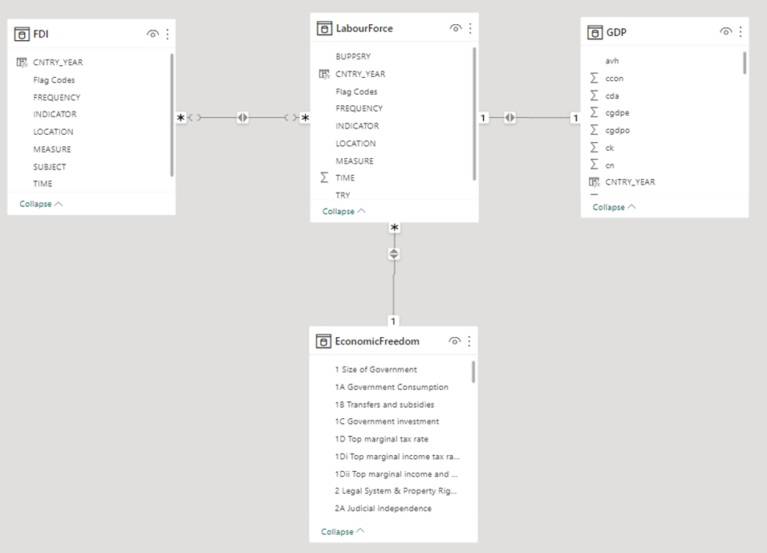
Entity Relationship (ER) Diagram

Slide 17

Data Visualizations & Exploration

Slide 18
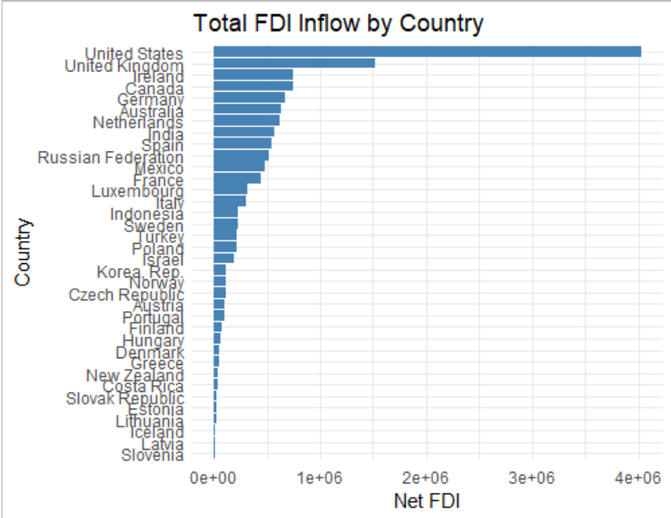
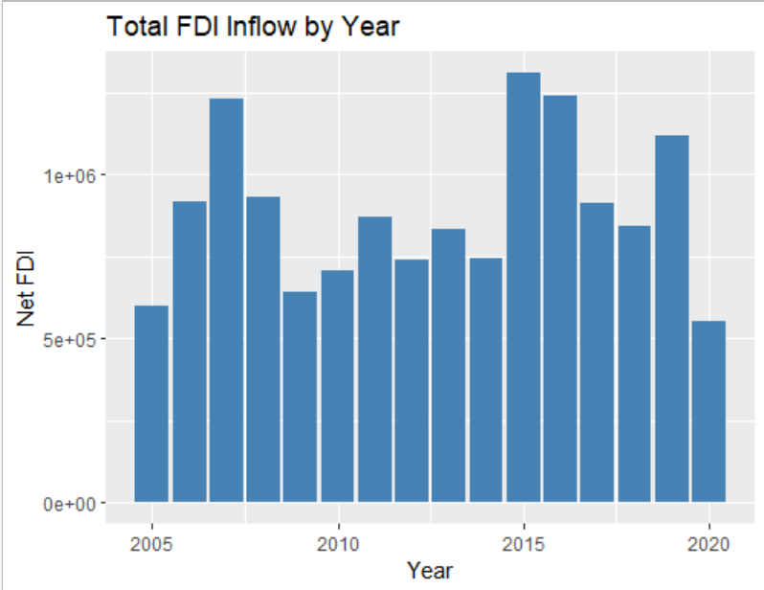
The bar graph has captured the FDI inflow for the years between 2005 to 2020, as the years 2007-08 had a recession and overall FDI went down has also been captured here
The graph has captured FDI for 36 countries across the world. As US has the highest FDI Inflow the essence of the same has been captured here in the graph.

Slide 19
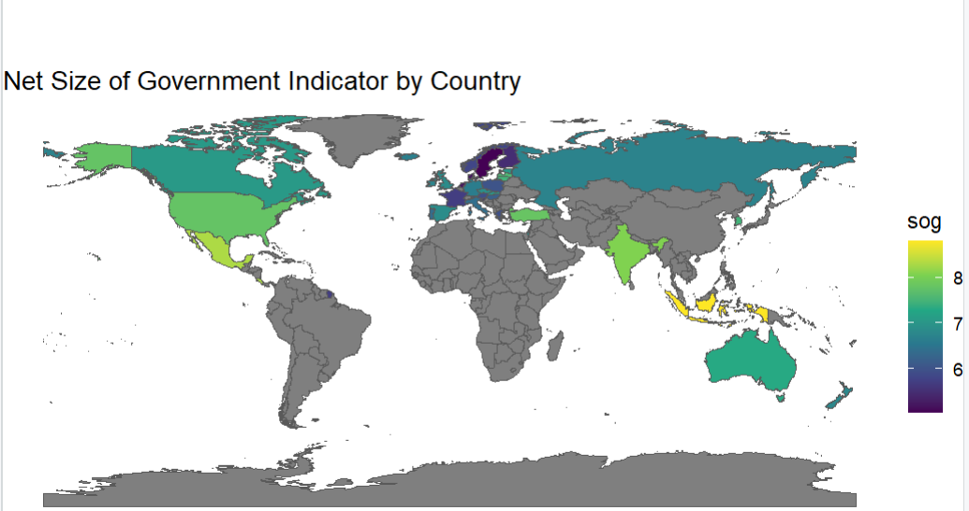
The maps show the Economic Indicator across different countries on a scale of 0-10 for :
Size of government
Legal System and Property Rights
Sound Money
Freedom of Trade and
Regulation

Slide 20
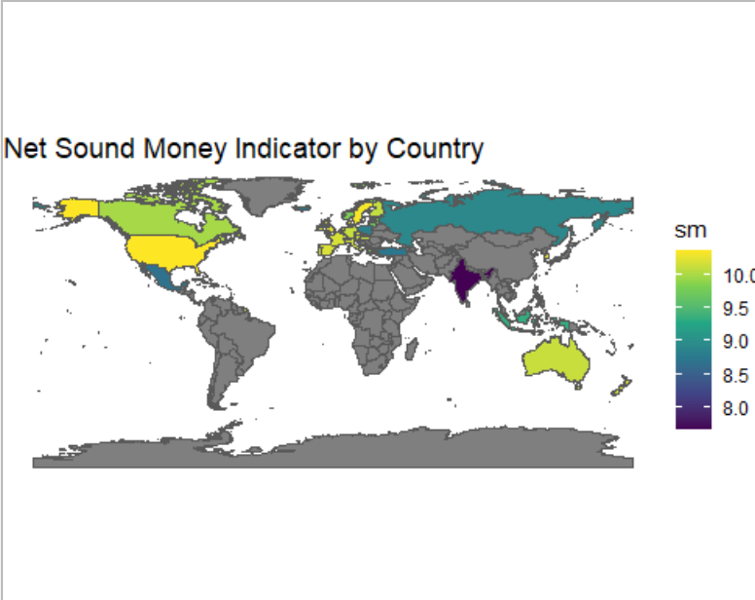
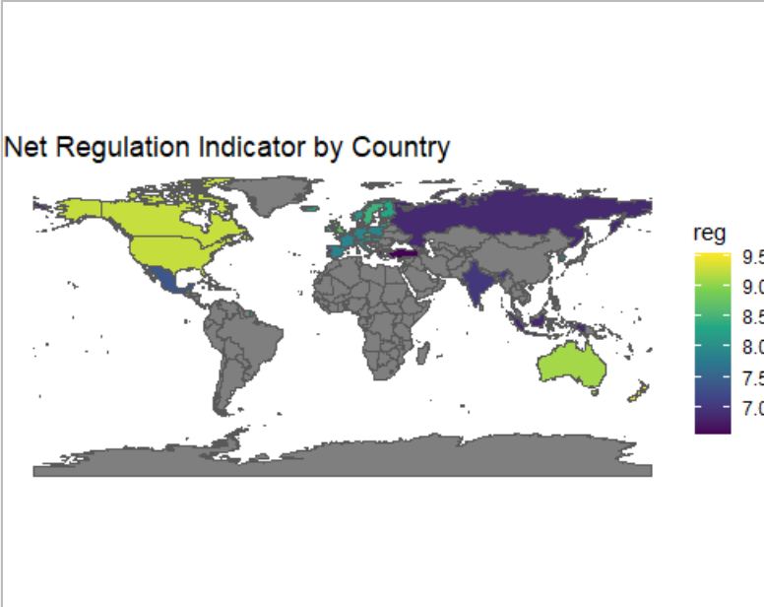
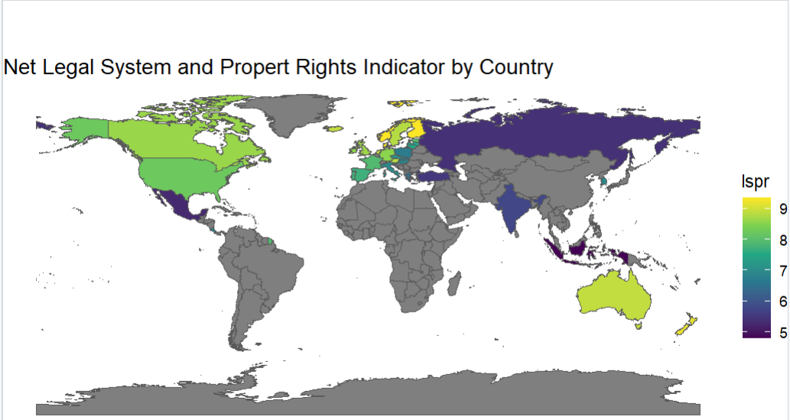
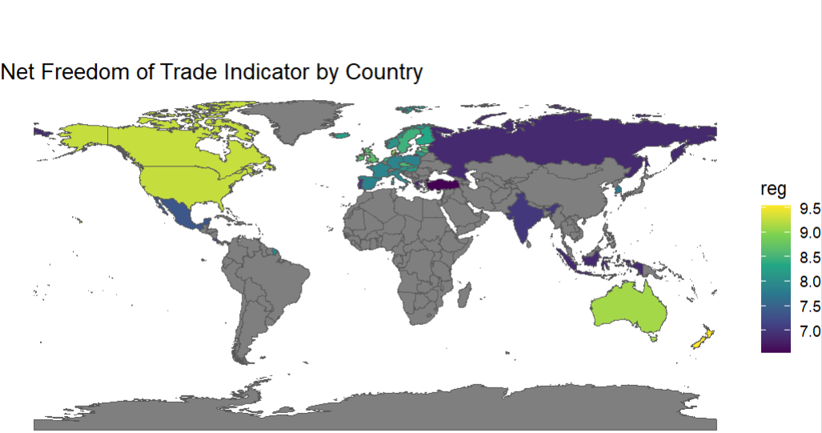

Slide 21
Model Consideration
There are three possible models that can be built with this dataset:
Labour Force Quality Effect Model:
mpanel_pf <- plm(df_nn$log.fdi.value ~ df_n$buppsry+df_n$try + df_n$uppsry_ntry+ economy,
data = df_nn, model ="random")
Economic Freedom Effect Model:
mpanel_pe <- plm(df_nn$log.fdi.value ~ df_nn$sog_gi + df_nn$sog_tmitr + df_nn$lspr_ji + df_nn$lspr_ppr + df_nn$sm_f + df_nn$free_t_m +df_nn$free_f + df_nn$reg_c_o + df_nn$reg_b_s + df_nn$reg_b_i + df_nn$free_r + df_nn$reg_l_h + economy, data = df_nn, model ="random")
Combined Effect Model:
mpanel_p <- plm(df_nn$log.fdi.value ~ df_nn$sog_gi + df_nn$sog_tmitr + df_nn$lspr_ji + df_nn$lspr_ppr + df_nn$sm_f + df_nn$free_t_m +df_nn$free_f + df_nn$reg_c_o + df_nn$reg_b_s + df_nn$reg_b_i + df_nn$free_r + df_nn$reg_l_h + df_nn$buppsry+ df_nn$try + df_nn$uppsry_ntry + economy, data = df_nn, model ="random")

Slide 22
THANK YOU

